Slide 1
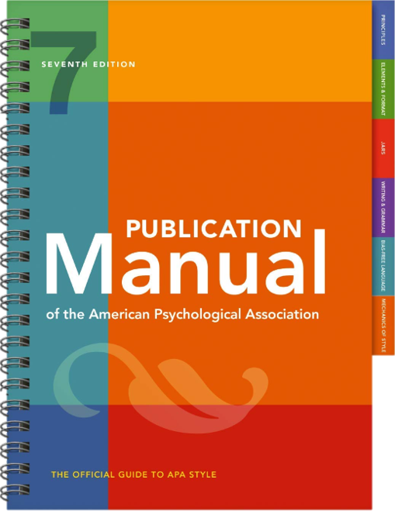
APA 7th VS 6TH
Gratia Christian College Library
Presented by Elaine Lam
GCC Librarian

Slide 2
Table of content
01
Journal Article
02
Book
03
Report
1.1 Journal Article (Eng)
1.2 Journal Article (Chin)
2.1 Book (Eng)
2.2 Book (Chin)
3.1 Report (Eng)
3.2 Report (Chin)
04
Website & Web page
05
Youtube Video
06
Thesis/Dissertation
4.1 Website
4.2 Web Page

Slide 3
Journal Article
Author | Date | Title | Source
 |  |  | Periodical information | DOI or URL
Author, A. A., & Author, B. B. Name of Group. Author, C. C. [username]. Username. | (2020). (2020, January). (2020, February 16). | Title of article. | Title of Periodical, 34(2), 5-14. Title of Periodical, 2(1-2), Article 12. Title of Periodical. | https://doi.org/xxxx https://xxxxx

Slide 4
1.1 Journal Article (eng)
1.2 Journal Article (chin)
Original (6th):
Chow, B. W. Y., Chiu, M. M., & Wong, S. W. L. (2011). Emotional Intelligence, Social Problem-Solving Skills, and Psychological Distress: A Study of Chinese Undergraduate Students. Journal Of Applied Social Psychology, 41(8), 1958-1980. doi: 10.1111/j.1559-1816.2011.00787.x
New (7th):
Chow, B. W. Y., Chiu, M. M., & Wong, S. W. L. (2011). Emotional intelligence, social problem-solving skills, and psychological distress: A study of Chinese undergraduate students. Journal of Applied Social Psychology, 41(8), 1958-1980. https://doi.org/10.1111/j.1559-1816.2011.00787.x
Original (6th):
林純真（2009）。<智障青年的戀愛經驗及觀點之探討>。《台灣性學學刊》，第15卷第一期：43-66。
New (7th):
林純真（2009）。<智障青年的戀愛經驗及觀點之探討>。《台灣性學學刊》，15（1），43-66。

Slide 5
2. Book
Author or editor | Date | Title | Source
 |  |  | Periodical information | DOI or URL
Author, A. A., & Author, B. B. Name of Group. Editor, E. E. (Ed.). Editor, E. E., & Editor, F. F. (Eds.). | (2020). | Title of book. Title of book (2nd ed., Vol. 4). Title of book [Audiobook]. Title of book (E. E. Editor, Ed.). Title of book (T. Translator, Trans.; N. Narrator, Narr.). | Publisher Name. First Publisher Name; Second Publisher Name. | https://doi.org/xxxx https://xxxxx

Slide 6
2.1 Book (eng)
2.2 Book (chin)
Original (6th):
Castells, M. (2010). The rise of the network society: The information age—Economy, society, and culture (2nd ed.). Malden, MA: Wiley-Blackwell.
New (7th):
Castells, M. (2010). The rise of the network society: The information age: Economy, society, and culture (2nd ed.). Wiley-Blackwell.
Original (6th):
葉光輝、楊國樞 （2008）。《中國人的孝道：心理學的分析》。台北：台灣大學出版社中心。
New (7th):
葉光輝、楊國樞 （2008）。《中國人的孝道：心理學的分析》。台灣大學出版社中心。

Slide 7
3. Report
Author | Date | Title | Source
 |  |  | Periodical information | DOI or URL
Author, A. A., & Author, B. B. Name of Group. | (2020). (2020, May 2). | Title of report. Title of report (Report No.123). Title of grey literature [Description]. | Publisher Name. | https://doi.org/xxxx https://xxxxx

Slide 8
3.1 report (eng)
3.2 report (chin)
Original (6th):
Joint Committee on Social Work Manpower Requirements. (2019). Social work manpower requirements system annual report 2019. Hong Kong. Retrieved from https://www.swd.gov.hk/storage/asset/section/296/en/SWMRS_Annual_Report_2019_Final.pdf
New (7th):
Joint Committee on Social Work Manpower Requirements. (2019). Social work manpower requirements system annual report 2019. HKSARG Social Welfare Department. https://www.swd.gov.hk/storage/asset/section/296/en/SWMRS_Annual_Report_2019_Final.pdf
Original (6th):
香港特別行政區政府（2020）。2019年香港貧窮情況報告。香港，香港特別行政區政府。
New (7th):
財政司司長辦公室、政府經濟顧問辦公室、政府統計處（2020年12月）。《2019年香港貧窮情況報告》。香港特別行政區政府扶貧委員會。https://www.povertyrelief.gov.hk/chi/pdf/Hong_Kong_Poverty_Situation_Report_2019.pdf

Slide 9
4. Website & web page
Author | Date | Title | Source
 |  |  | Periodical information | DOI or URL
Author, A. A., & Author, B. B. Name of Group. | (2020). (2020, August). (2020, September 28). (n.d.). | Title of work. | Site Name. | https://xxxxx Retrieved December 22, 2020, from https://xxxxx

Slide 10
4.1 website
4.2 web page
Commission on Poverty (https://www.povertyrelief.gov.hk/)
Original (6th):
Commission on Poverty. (2021). Welcome Message. Retrieved 25 June 2021, from https://www.povertyrelief.gov.hk/eng/welcome.html
New (7th):
HKSARG Commission on Poverty. (2021). Welcome Message. https://www.povertyrelief.gov.hk/eng/welcome.html
Bologna, C. (2018, June 27). What happens to your mind and body when you feel homesick? HuffPost. https://www.huffingtonpost.com/entry/what-happens-mind-body-homesick_us_5b201ebde4b09d7a3d77eee1

Slide 11
5. Youtube video
Author | Date | Title | Source
 |  |  | Periodical information | DOI or URL
Director, D. D. (Director). Producer, P. P. (Executive Producer). Host, H. H. (Host). Artist, A. A. Uploader, U. U. | (2020). (1989-present). (2013-2019). (2019, July 21) | Title of work. [Description] | Production Company. Label. Museum Name, Museum Location. Department Name, University Name. | https://xxxxx
Original (6th):
Lama, D. (2020, December 15). The Purpose of Life. [Video file]. Retrieved from https://www.youtube.com/watch?v=VYeomOFpLZE
New (7th):
Lama, D. (2020, December 15). The purpose of life [Video]. Youtube. https://www.youtube.com/watch?v=VYeomOFpLZE

Slide 12
6. Thesis/Dissertation
Author | Date | Title | Source
 |  |  | Periodical information | DOI or URL
Author, A. A. | (2020). | Title of dissertation [Doctoral dissertation, Name of Institution Awarding the Degree]. Title of thesis [Master's thesis, Name of Institution Awarding the Degree]. | Database Name. Archive Name. | https://xxxxx
Original (6th):
Chan, N. M. (2007). Epistemological beliefs and critical thinking among Chinese students. (Postgraduate thesis, University of Hong Kong, Hong Kong). Retrieved from http://hub.hku.hk/handle/10722/52503
New (7th):
Chan, N. M. (2007). Epistemological beliefs and critical thinking among Chinese students. [Postgraduate thesis, University of Hong Kong]. The HKU Scholars Hub. http://hub.hku.hk/handle/10722/52503
Hollander, M. M. (2017). Resistance to authority: Methodological innovations and new lessons from the Milgram experiment (Publication No. 10289373) [Doctoral dissertation, University of Wisconsin-Madison]. ProQuest Dissertations and Theses Global.

Slide 13
THANKS
Do you have any questions?
Email: libinfo@gratia.edu.hk
Tel: 5804 4141
Website: http://www.gcc.edu.hk/library/

