Slide 1
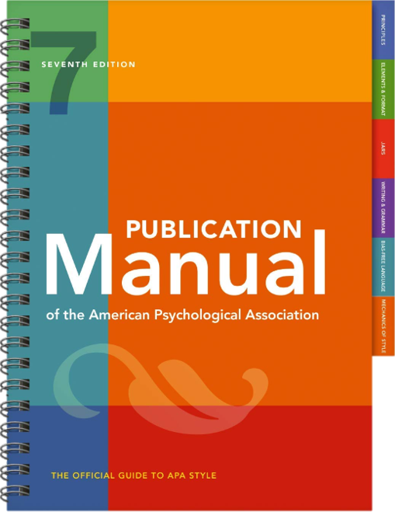
APA 7th Easy Guide
Gratia Christian College Library
Presented by Elaine Lam
GCC Librarian

Slide 2
Table of content
Book Section
Journal Article
Legal
1.1 Journal Article with a DOI
1.2 Journal Article with an URL
Book
Paper Presentation
2.1 Book with a DOI
2.2 Book without a DOI
Book Chapter
Thesis/Dissertation
3.1 Book Chapter without a DOI

Slide 3
1.Journal Article
Author | Date | Title | Source
 |  |  | Periodical information | DOI or URL
Author, A. A., & Author, B. B. Name of Group. Author, C. C. [username]. Username. | (2020). (2020, January). (2020, February 16). | Title of article. | Title of Periodical, 34(2), 5-14. Title of Periodical, 2(1-2), Article 12. Title of Periodical. | https://doi.org/xxxx https://xxxxx
Journal Article with a DOI
Abdul, G. K. A., Moh, H. Y., & Ying-Leh, L. (2016). Teachers’ morale and school effectiveness in secondary schools of Sibu, Sarawak. International Journal of Education, Culture and Society, 1(2), 52-57. https://doi.org/10.11648/j.ijecs.20160102.14
Journal Article with an URL
Allen, N., Grigsby, B., & Peters, M. L. (2015). Does leadership matter? Examining the relationship among transformational leadership, school climate, and student achievement. International Journal of Educational Leadership Preparation, 10(2), 1-22. https://files.eric.ed.gov/fulltext/EJ1083099.pdf

Slide 4
2. Book
Author or editor | Date | Title | Source
 |  |  | Periodical information | DOI or URL
Author, A. A., & Author, B. B. Name of Group. Editor, E. E. (Ed.). Editor, E. E., & Editor, F. F. (Eds.). | (2020). | Title of book. Title of book (2nd ed., Vol. 4). Title of book [Audiobook]. Title of book (E. E. Editor, Ed.). Title of book (T. Translator, Trans.; N. Narrator, Narr.). | Publisher Name. First Publisher Name; Second Publisher Name. | https://doi.org/xxxx https://xxxxx
Book with a DOI
Bolman, L. G., & Deal, T. E. (2017). Reframing organizations: Artistry, choice, and leadership (6th ed.). Jossey-Bass. https://doi.org/10.1002/9781119281856
Book without a DOI
Brookover, W. B., Beady, C., Flood, P., Schweitzer, J., & Wisenbaker, J. (1979). School social systems and student achievement: Schools can make a difference. Praeger.

Slide 5
3. Book Chapter
Author | Date | Title | Source
 |  |  | Periodical information | DOI or URL
Author, A. A., & Author, B. B. Name of Group. | (2020). | Title of chapter. | In E. E. Editor (Ed.), Title of book (pp. 3-13). Publisher Name. In E. E. Editor & F. F. Editor (Eds.), Title of book (3rd ed., Vol. 2, pp. 212-255). Publisher Name. | https://doi.org/xxxx https://xxxxx
Book Chapter without a DOI
Bennis, W. (1986). Transformative power and leadership. In T. J. Sergiovanni & J. E. Corbally (Eds.), Leadership and organizational culture: New perspectives on administrative theory and practice. University of Illinois Press.
DuFour, R., & Eaker, R. (1991). The principal as leader: Promoting values, empowering teachers. In P. George & E. C. Potter (Eds.), School-based management: Theory and practice (pp. 47-52). National Association of Secondary School Principals.

Slide 6
4. Book Section
Wilson-Evered, E., Härtel, C. E. J., & Neale, M. (2001). A longitudinal study of work group innovation: The importance of transformational leadership and morale. In Advances in Health Care Management (Vol. 2, pp. 315-340). Emerald. https://doi.org/10.1016/s1474-8231(01)02032-8
5. Legal
Education (Amendment) Ordinance, Ordinance No. 27, (2004). https://www.elegislation.gov.hk/hk/2004/27!en

Slide 7
6. Paper Presentation
Author | Date | Title | Source
 |  |  | Periodical information | DOI or URL
Presenter, A. A., & Presenter, B. B | (2020, September 18-20) (2020, October 30- November 1). | Title of contribution [Type of contribution]. | Conference Name, Location. | https://doi.org/xxxx https://xxxxx
Goddard, Y. L., Miller, R., Larson, R., & Goddard, R. (2010, Apr 30-May 4). Connecting principal leadership, teacher collaboration, and student achievement [Paper presentation]. Annual Meeting of the American Educational Research Association, Denver, CO, United States.
Sheppard, B., Hurley, N., & Dibbon, D. (2010). Distributed leadership, teacher morale, and teacher enthusiasm: Unravelling the leadership pathways to school success [Paper presentation]. Annual Meeting of the American Educational Research Association, Denver, CO, United States. https://eric.ed.gov/?id=ED509954

Slide 8
7. Dissertation
Author | Date | Title | Source
 |  |  | Periodical information | DOI or URL
Author, A. A. | (2020). | Title of dissertation [Doctoral dissertation, Name of Institution Awarding the Degree]. Title of thesis [Master's thesis, Name of Institution Awarding the Degree]. | Database Name. Archive Name. | https://xxxxx
Kemp, L., & Hall, A. H. (1992). Impact of effective teaching research on student achievement and teacher performance: Equity and access implications for quality education (ERIC Document Reproduction Service No. ED348360). Jackson State University.
Webb, D. O. (2014). The relationship between principal leadership and teacher morale in the elementary schools in a Northwest Georgia school district (Publication Number 807) [Doctoral dissertation, Liberty University]. Scholars Crossing. https://digitalcommons.liberty.edu/doctoral/807

Slide 9
Thanks!
Do you have any questions?
Email: libinfo@gratia.edu.hk
Tel: 5804 4141
Website: http://www.gcc.edu.hk/library/

